Slide 1

Manifesto for Human(e) Leadership
We believe in the creativity and motivation of human beings. We consider human leadership as pivotal in a highly networked and highly complex world. We understand the task of leadership as serving life and striving for conditions in which people, in their diversity, can contribute in the best possible way and in which they can develop themselves and work effectively together.
These values are important to us:
Marcus Raitner, fuehrung-erfahren.de

Slide 2
The Book
Unleashing human potential
over employing human resources.
Diversity and dissent
over conformity and consensus.
Purpose and trust
over command and control.
Contributions to networks
over position in hierarchies.
Growing leaders
over leading followers.
Courageously exploring the new
over efficiently exploiting the old.
That is, while there is value in the items on the right,
we value the items on the left more.
DE: https://leanpub.com/menschlichefuehrung
EN: https://leanpub.com/humanleadership

Slide 3


Unleashing human potential
10
9
8
7
over
6
5
4
3
2
employing human ressources
1
Marcus Raitner, fuehrung-erfahren.de

Slide 4

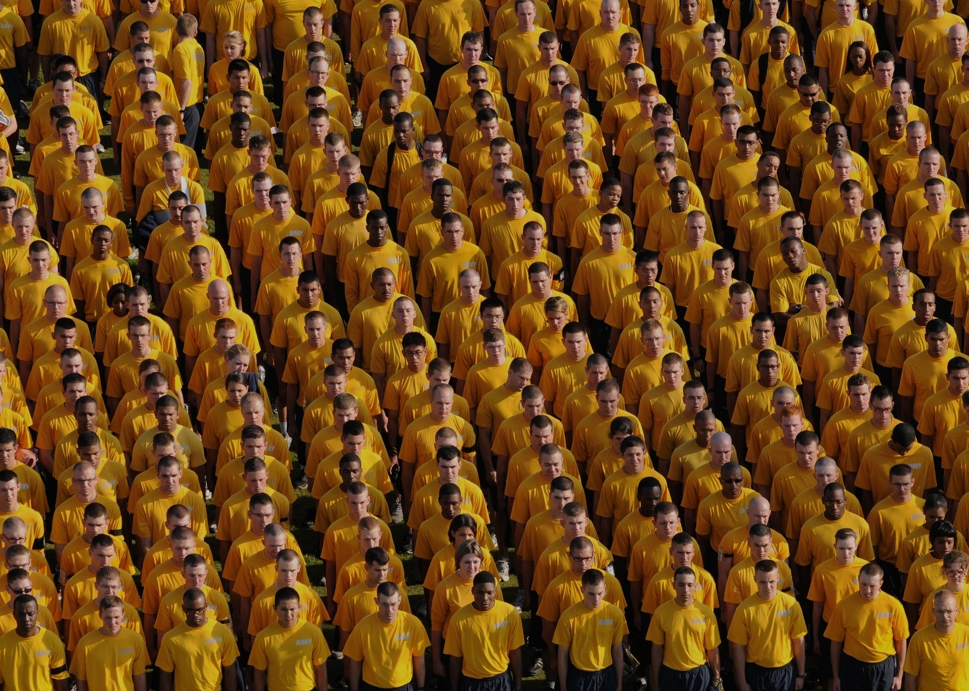
Diversity and dissent
10
9
8
7
over
6
5
4
3
2
conformity and consensus
1
Marcus Raitner, fuehrung-erfahren.de

Slide 5


Purpose and trust
10
9
8
7
over
6
5
4
3
2
command and control
1
Marcus Raitner, fuehrung-erfahren.de

Slide 6


Contributions to networks
10
9
8
7
over
6
5
4
3
2
positions in hierarchies
1
Marcus Raitner, fuehrung-erfahren.de

Slide 7


Growing leaders
10
9
8
7
over
6
5
4
3
2
leading followers
1
Marcus Raitner, fuehrung-erfahren.de

Slide 8


Couragously exploring the new
10
9
8
7
over
6
5
4
3
2
efficiently exploiting the old
1
Marcus Raitner, fuehrung-erfahren.de

